Slide 1
English Class
What time do you get up?

Slide 2
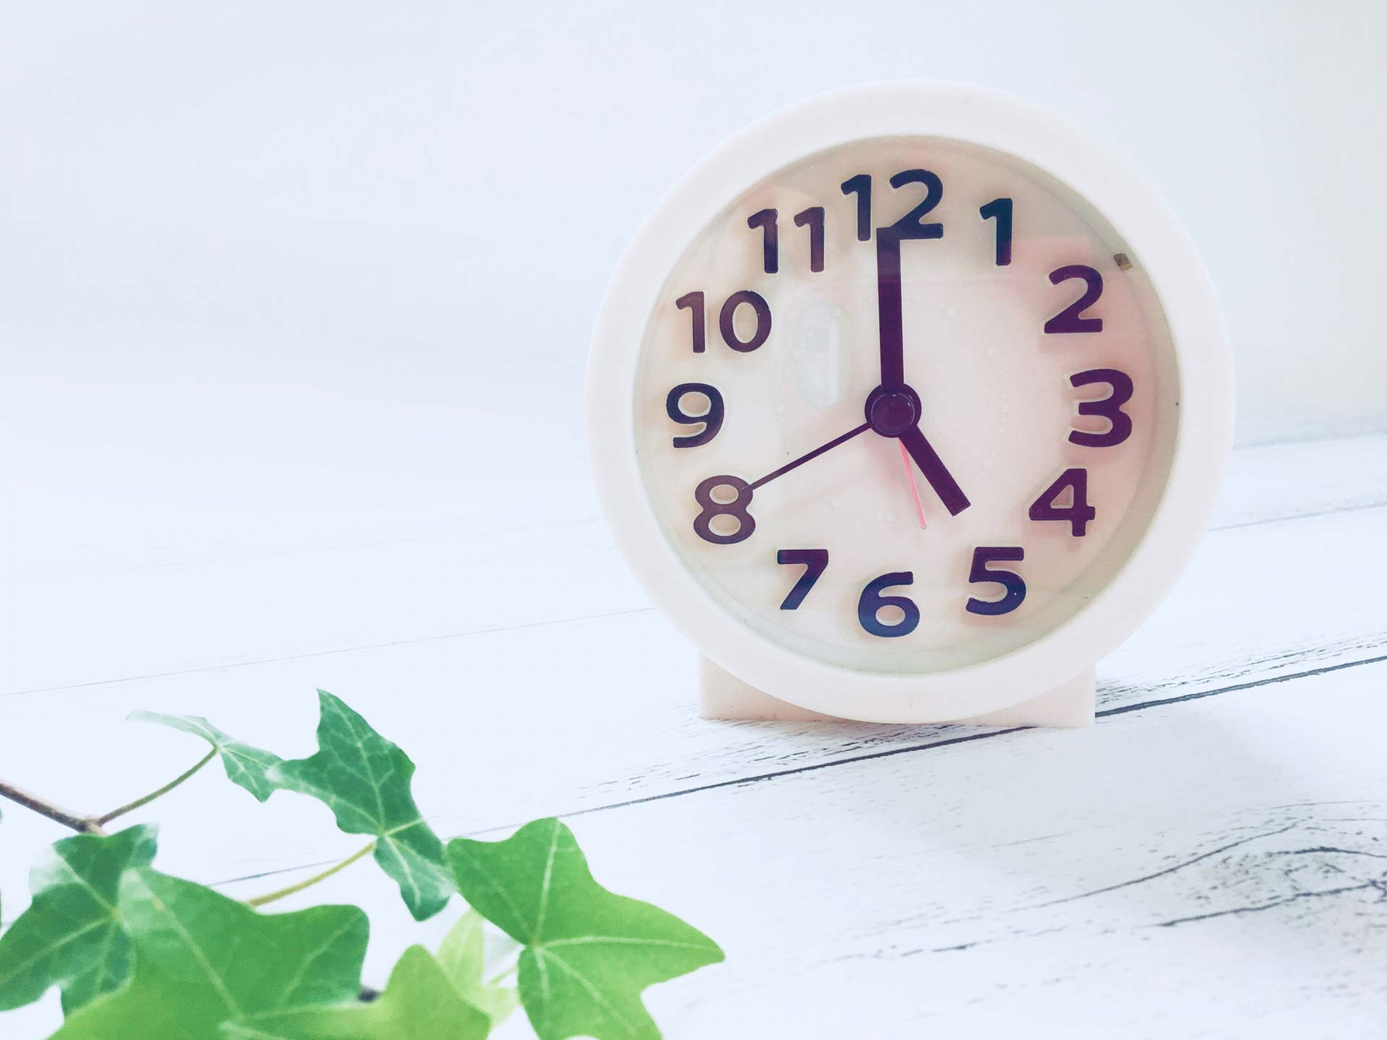
Review
What time is it?
It’s five o’clock.

Slide 3
Review
What time is it?
It’s ten ten.
(ten past ten)

Slide 4
This is my daily life.

Slide 5
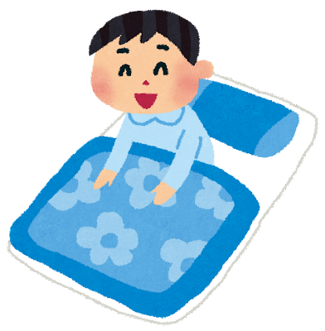
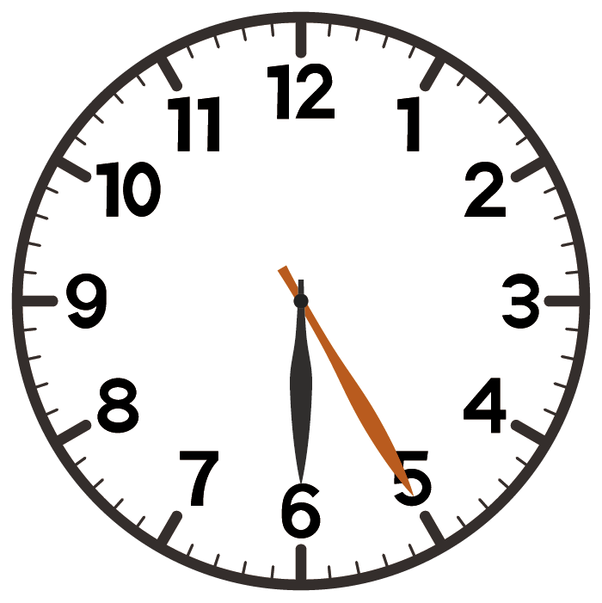

Slide 6
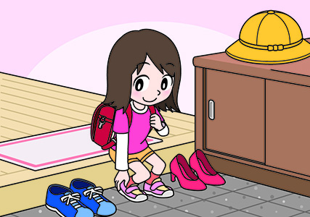
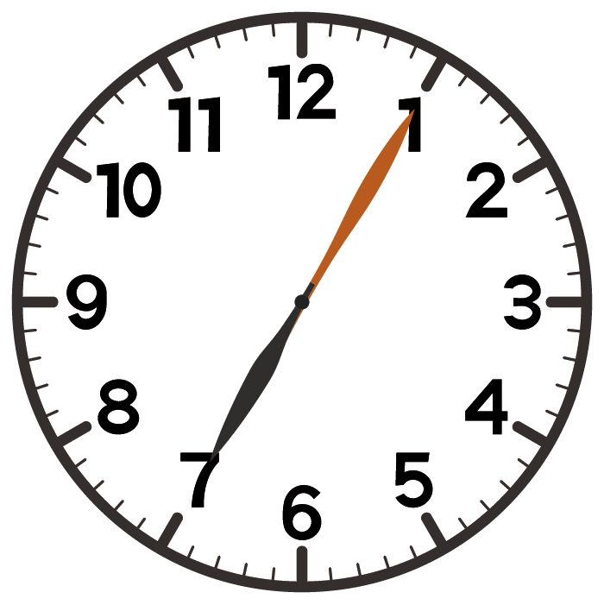

Slide 8
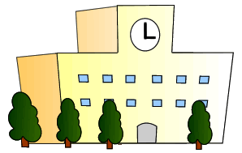
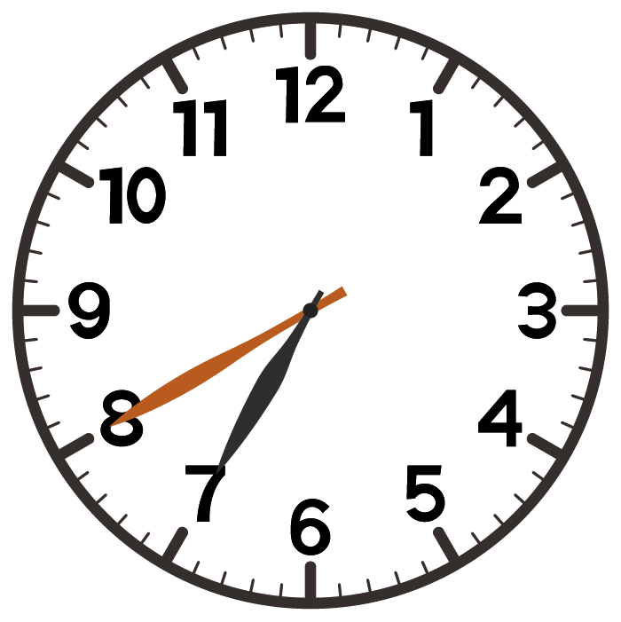

Slide 9
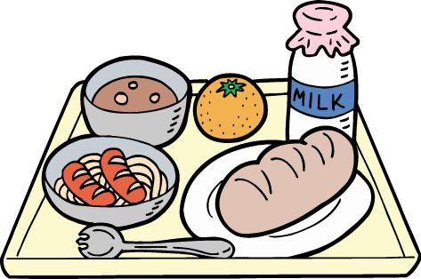
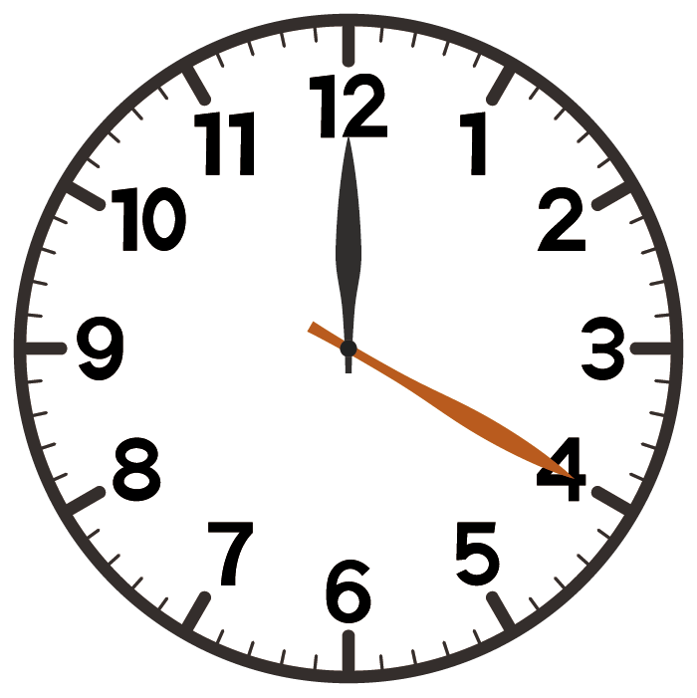

Slide 10
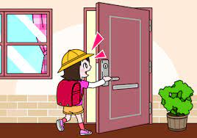
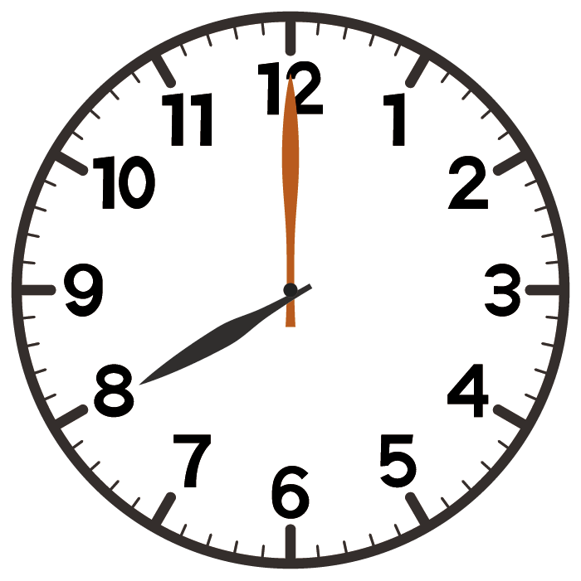

Slide 11
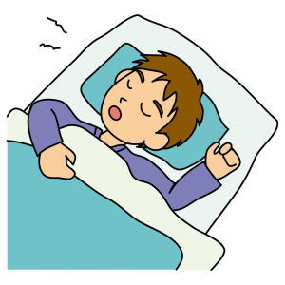
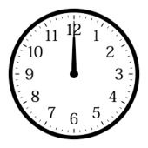

Slide 12
さて、何を話していた？ 確認してみよう！

Slide 20
What time パート２
What time と
be動詞が合体
What time is it? --- It’s one.
→何時ですか。 --- 1時です。
What time do you get up?
→あなたは何時に起きますか。
I get up at seven.
→私は7時に起きます。
What time と
一般動詞が合体

Slide 21
Let’s Practice!

Slide 22
What time do you get up?
I get up at six thirty.

Slide 23
What time do you leave home?
I leave home at seven.

Slide 24
I come to school by car.

Slide 25
What time do you get to school?
I get to school at seven forty.

Slide 26
What time do you have lunch?
I have lunch at twelve twenty.

Slide 27
What time do you go home?
I go home at eight.

Slide 28
What time do you go to bed?
I go to bed at twelve.

Slide 29
What time パート２
What time と
be動詞が合体
What time is it? --- It’s one.
→何時ですか。 --- 1時です。
What time do you get up?
→あなたは何時に起きますか。
I get up at seven.
→私は7時に起きます。
What time と
一般動詞が合体

