Slide 1
English Class
What time is it?

Slide 2
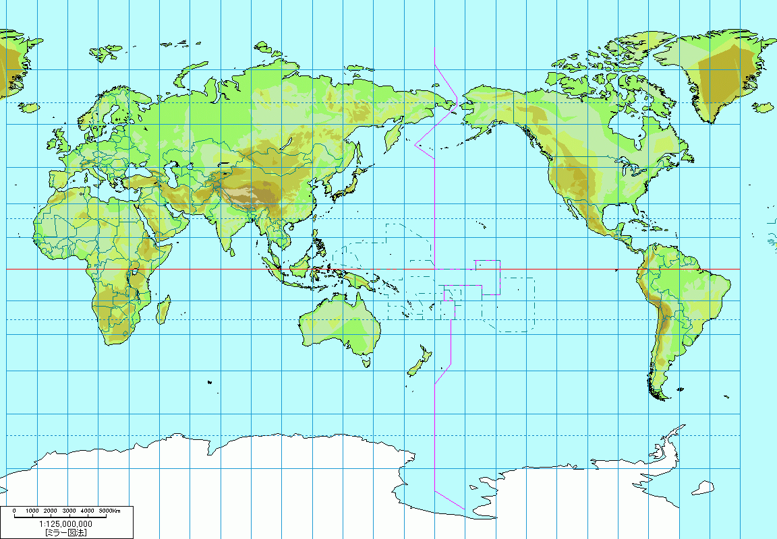
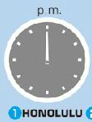
What time is it?

Slide 3
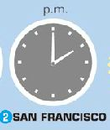
What time is it?

Slide 4
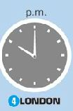
What time is it?

Slide 5
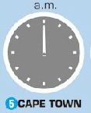
What time is it?

Slide 6
What time is it?

Slide 7
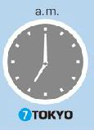
What time is it?

Slide 8
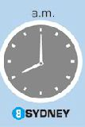
What time is it?

Slide 9
まとめ！
What time ~ ? 時間を訪ねる。
What time is it? 何時ですか。
----- It is seven (o’clock). 7時です。
★この場合の it に意味はない。
（天気や曜日、日付と同じ）

Slide 10
What time is it?
It’s twelve.

Slide 11
What time is it?
It’s twelve o’clock.

Slide 12
What time is it?
It’s two o’clock.

Slide 13
What time is it?
It’s five twenty.

Slide 14
What time is it?
It’s seven fifteen.

Slide 15
What time is it?
It’s eleven thirty.

Slide 16
What time is it?
It’s nine twenty.

Slide 17
What time is it?
It’s ten forty-five.

Slide 18
What time is it?
It’s one thirty.

Slide 19
What time is it?
It’s six o’clock.

Slide 20
What time is it?
It’s seven fifty.

Slide 21
まとめ！
What time ~ ? 時間を訪ねる。
What time is it? 何時ですか。
----- It is seven (o’clock). 7時です。
★この場合の it に意味はない。
（天気や曜日、日付と同じ）

