Slide 1
English Class
I want to sleep.

Slide 2
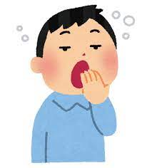
What do you want to do?
You

Slide 3
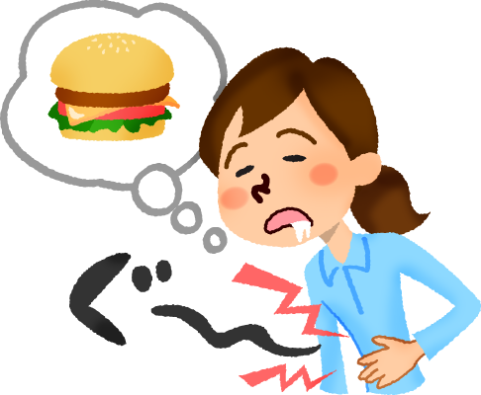
What do you want to do?
You

Slide 4
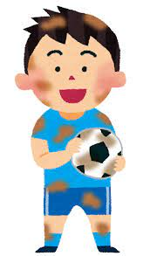
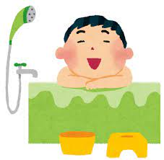
What do you want to do?
You

Slide 5
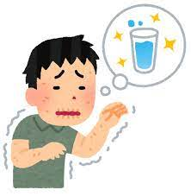
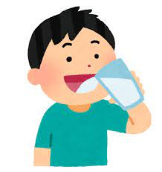
What do you want to do?
You

Slide 6
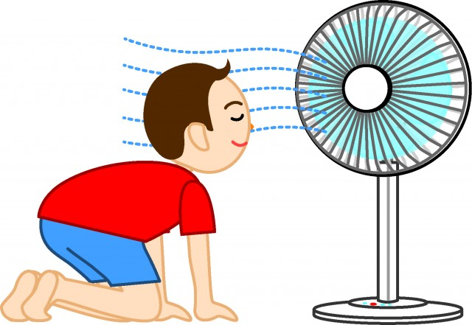
What do you want to do?
You

Slide 7
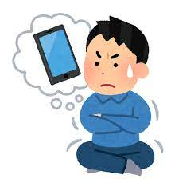
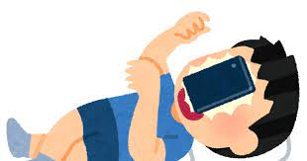
What do you want to do?
You

Slide 8
何を聞いている？
What do you want to do?
あなたは何がしたいですか？
I want to sleep.
私は寝たいです。

Slide 9
今日のターゲット！
I want to sleep.
私は寝たいです。
want to 動詞で「～がしたいです」

Slide 10
Let’s Practice!

Slide 11
What do you want to do?
I want to sleep.

Slide 12
What do you want to do?
I want to eat.

Slide 13
What do you want to do?
I want to take a bath.

Slide 14
What do you want to do?
I want to drink water.

Slide 15
What do you want to do?
I want to use a fan.

Slide 16
What do you want to do?
I want to use a smart phone.

Slide 17
今日のターゲット！
I want to sleep.
私は寝たいです。
want to 動詞で「～がしたいです」

