Slide 1
English Class
How do you come to school?

Slide 2
Do you come to school every day?
Yes, I do. / No, I dont.

Slide 3
How do you come to school?
I walk to school.

Slide 4
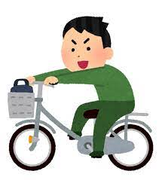
How do you come to school?
I come to school by bike.

Slide 5
How do you come to school?
I come to school by car.

Slide 6
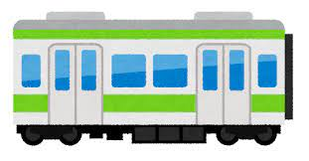
How do you come to school?
I come to school by train.

Slide 7
How do you come to school?
I come to school by plane.

Slide 8
How do you come to school?
I come to school by balloon.

Slide 9
How do you come to school?
I come to school by spaceship.

Slide 10
How do you come to school?
あなたはどうやって学校に来ますか。
I walk to school.
歩いて学校に行きます。

Slide 11
How do you come to school?
あなたはどうやって学校に来ますか。
I come to school by bike.
自転車で学校に来ます。

Slide 12
Howってどんな意味？
How do
Do you come to school?
どうやって
あなたは学校に来ますか。
howは「手段」や「方法」を
尋ねることができる！！

Slide 13
Let’s Practce!

Slide 14
How do you come to school?
I walk to school.

Slide 15
How do you come to school?
I come to school by bike.

Slide 16
How do you come to school?
I come to school by car.

Slide 17
How do you come to school?
I come to school by train.

Slide 18
How do you come to school?
I come to school by plane.

Slide 19
How do you come to school?
I come to school by balloon.

Slide 20
How do you come to school?
I come to school by spaceship.

Slide 21
Howってどんな意味？
How do
Do you come to school?
どうやって
あなたは学校に来ますか。
howは「手段」や「方法」を
尋ねることができる！！

