Slide 1
English Class
What do you have for breakfast?

Slide 2
Do you have breakfast?

Slide 3
What do you have for breakfast?

Slide 4
Japan

Slide 5
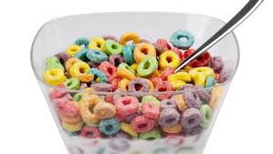
America

Slide 6
India

Slide 7
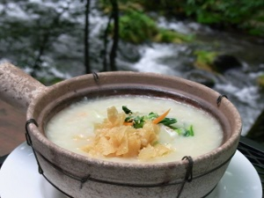
China

Slide 8
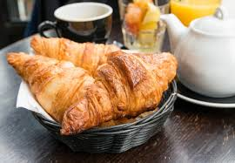
France

Slide 9
England

Slide 10
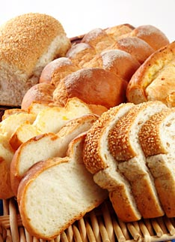
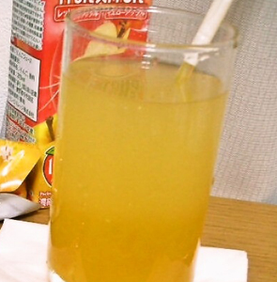
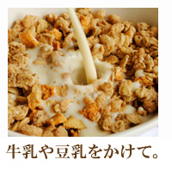
What do you have for breakfast?

Slide 11
What do you have for breakfast?
I have rice.

Slide 12
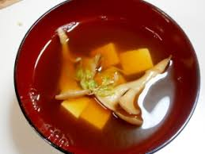
What do you have for breakfast?
I have miso soup.

Slide 13
What do you have for breakfast?
I have toast.

Slide 14
What do you have for breakfast?
I have cereal.

Slide 15
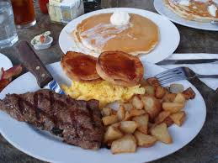
What do you have for breakfast?
I have steak.

Slide 16
What do you have for breakfast?
I have milk.

Slide 17
What do you have for breakfast?
I have orange juice.

Slide 18
Check! 何を聞いて、何を答えていた？
What do you have for
breakfast?
あなたは朝食に何を食べますか。
I have toast.
わたしはトーストを食べます。

Slide 19
ちなみに先生は・・・

Slide 20
Let’s Practice!

Slide 21
What do you have for breakfast?
I have rice.

Slide 22
What do you have for breakfast?
I have miso soup.
I have miso soup.

Slide 23
What do you have for breakfast?
I have toast.

Slide 24
What do you have for breakfast?
I have cereal.

Slide 25
What do you have for breakfast?
I have steak.

Slide 26
What do you have for breakfast?
I have milk.

Slide 27
What do you have for breakfast?
I have orange juice.

Slide 28
Check!
What do you have for
breakfast?
あなたは朝食に何を食べますか。
I have toast.
わたしはトーストを食べます。

