Slide 1
English Class
I want to be a baseball player.

Slide 2
What do you want to be?
You

Slide 3
What do you want to be?
You

Slide 4
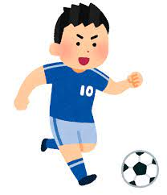
What do you want to be?
You

Slide 5
What do you want to be?
You

Slide 6
What do you want to be?
You

Slide 7
What do you want to be?
You

Slide 8
What do you want to be?
You

Slide 9
何を聞いている？
What do you want to be?
あなたは何になりたいですか？
I want to be a magician.
私は魔法使いになりたいです。

Slide 10
今日のターゲット！
I want to be a magician.
私は魔法使いになりたいです。
want to be「～になりたいです」

Slide 11
What do you want to be?
I want to be a singer.

Slide 12
What do you want to be?
I want to be a baseball player.

Slide 13
What do you want to be?
I want to be a soccer player.

Slide 14
What do you want to be?
I want to be a You tuber.

Slide 15
What do you want to be?
I want to be a president.

Slide 16
What do you want to be?
I want to be an astronaut.

Slide 17
今日のターゲット！
I want to be a magician.
私は魔法使いになりたいです。
want to be「～になりたいです」

